Slide 1


National Education Society®
JNN College of Engineering, Shivamogga
Dept. of Information Science and Engineering
Final Project(18ISP78) Presentation on
“Image encryption using DNA addition combining with chaotic maps ”
Under Guidance of : Mr. Sayed Aftab Ahamed _{B.E, MTech.} Assistant Professor Dept. of IS&E JNNCE ,Shimoga. |  | Presented By : Sushma H P -4JN18IS105 Syeda Fathima Zahara-4JN18IS108 Zubia A Khan -4JN18IS118 Pooja Reddy K -4JN19IS408
6/24/2022
Image encryption using DNA addition combining with chaotic maps
1

Slide 2

Contents
Introduction
Problem Description
Objectives
Literature Survey
System Design and Implementation
Results
Analysis
References
6/24/2022
Image encryption using DNA addition combining with chaotic maps
2

Slide 3
1. Introduction
In this project an efficient image encryption scheme based on DNA sequence addition operation and chaos been proposed. The proposed algorithm consists of three stages: First, a DNA sequence matrix is obtained by encoding the original image, then, divide the DNA sequence matrix into some equal blocks and use the DNA sequence addition operation to add these blocks. Next, perform the DNA sequence complement operation to the result of the added matrix by using two Logistic maps. Finally, decode the DNA sequence matrix from the third step, and we can get the encrypted image.
6/24/2022
Image encryption using DNA addition combining with chaotic maps
2

Slide 4
2.Problem Statement
In cryptography there is a constraint of co-relation coefficient and it takes long time. To overcome this, we prefer DNA sequence addition operation and chaos. Hence, Chaotic systems are distinguished by sensitive dependence on initial conditions and by having evolution through phase space that appears to be quite random.
The behavior of a chaotic system is unpredictable. Therefore, it resembles noise. Hence it is required to design a secure chaotic based encryption system which takes images as input and encrypts the image into cipher text.
6/24/2022
Image encryption using DNA addition combining with chaotic maps
4

Slide 5
3.Objectives
To design an image encryption system using DNA sequence addition and chaos cryptography having less Peak Signal to Noise Ratio (PSNR) and high Mean Square Error.
To analyze the performance of the developed chaotic cryptographic system .
To find the Histogram error between the images.
To achieve high entropy value.
To analyze the randomness of the generated chaotic sequences.
6/24/2022
Image encryption using DNA addition combining with chaotic maps
5

Slide 6
5.System Design and Implementations
In this section, we will study the procedure of image encryption based on the DNA sequence addition operation in detail. Firstly, produce secret keys. Secondly, divide the original image into blocks and add these blocks by using the DNA sequence addition operation. Thirdly, carry out the DNA sequence complement operation for the resulting added matrix using two Logistic maps. Lastly, decoding the result from the third stage, we obtain the encrypted image.
6/24/2022
Image encryption using DNA addition combining with chaotic maps
11

Slide 7
5.System Design and Implementation
Algorithm:
Step 1: Convert the image into a binary matrix, then carry out DNA encoding for the binary matrix according to obtain a coding matrix Ab, the size of Ab is (m, n × 4)
Step 2: Divide Ab into some equal blocks Ab {i, j}, i = 1, 2, . . ., m 4, j = 1, 2, . . ., n, where the size of blocks is 4 × 4;
Step 3: Generate two chaotic sequences X = {x1, x2, . . ., x m 4},
Y = {y1, y2, . . ., yn}, through 2D Logistic map under the condition that the initial values are x0, y0 and system parameters are µ1, µ2;
Step 4: Sorting X, Y in ascending order, we get two new sequences X 0, Y 0.
Step 5: Let the location value of sequences X 0, Y 0 be row coordinates and column coordinates of Ab {i, j}, in other words, it can be expressed as Ab {x 0 p, y 0 q}, where {x 0 1, x 0 2, . . ., x 0 p, . . ., x 0 m 4} and {y 0 1, y 0 2, . . ., y 0 q, . . ., x 0 n} are the location values of sequences X 0, Y 0, respectively;
Step 6: Add Ab {i, j} and Ab {x 0 p, y 0 q} according to the rules in Section 2.2.2, obtaining the result as blocks B {i, j}.
6/24/2022
Image encryption using DNA addition combining with chaotic maps
12

Slide 8
5.System Design and Implementation
Step 7: Recombining these blocks, B {i, j}, we will get a new sequence matrix C.
Step 8: Two chaotic sequences z1 and z2 are produced by two 1D Logistic maps, whose lengths are m and n×4. Reconstruct z1 and z2 as two matrices Z1 (m, 1) and Z2 (1, n × 4). Performing the multiply operation for Z1(m, 1) and Z2(1, n × 4), we obtain the matrix Z whose size is m × n × 4.
Map the value of Z into (0,1) by mod (Z, 1). Then use the following threshold function f(x) to get a binary sequence matrix:
Step 9: If Z {i, j} = 1, C {i, j} is complemented, otherwise it is unchanged. After the complementing operation, we get a new coding matrix C 0;
Step 10: Carry out the inverse process of the step 1 for the coding matrix C 0, we will obtain a real value matrix D, then output image D, which is our encrypted image.
6/24/2022
Image encryption using DNA addition combining with chaotic maps
12

Slide 9
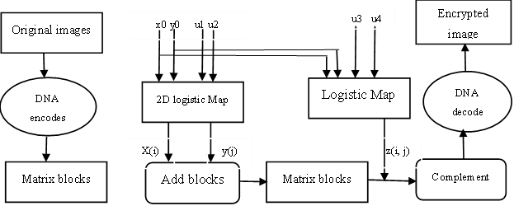

Slide 10


5.System Design and Implementation
Generation of secret key:
We will generate the secret key. Input an 8-bit grey image A as the original image, A = A(aij), i = 1, 2, . . ., m, j = 1, 2, . . ., n. Here, aij is the value of the image pixel, (i, j) is pixel position, and (m, n) is the size of image. Using these formulas we can calculate K1 and K2
The security analysis: The encryption algorithm resists all kinds of known attacks, such as exhaustive attack, statistical attack and differential attack.
Secret key’s sensitivity analysis: The 2D Logistic and 1D Logistic chaotic maps are sensitive to the system parameters and initial values. If they have a slight difference, the decrypted image has no connection with the original image.
6/24/2022
Image encryption using DNA addition combining with chaotic maps
13

Slide 11
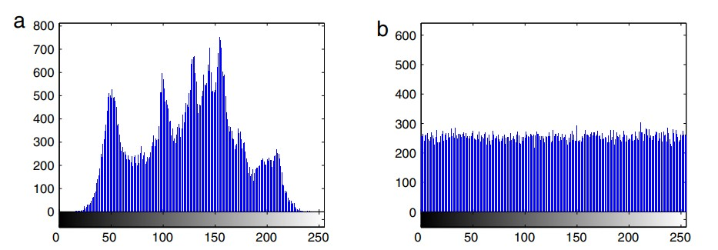
5.System Design and Implementation
The result of decrypted image and histogram of decrypted image is fairly uniform and the decrypted image is different from the original image.
Fig 5.1: The grey histogram of the (a)original image and (b)the encrypted image.
A histogram tells us the frequency of each intensity value in the
gray-scale equivalent of a picture. It plots each of the intensity values versus the number of pixels that has that value. It is conceptually important, as it gives us an idea of the distribution of various intensity values in a picture.
6/24/2022
Image encryption using DNA addition combining with chaotic maps
14

Slide 12
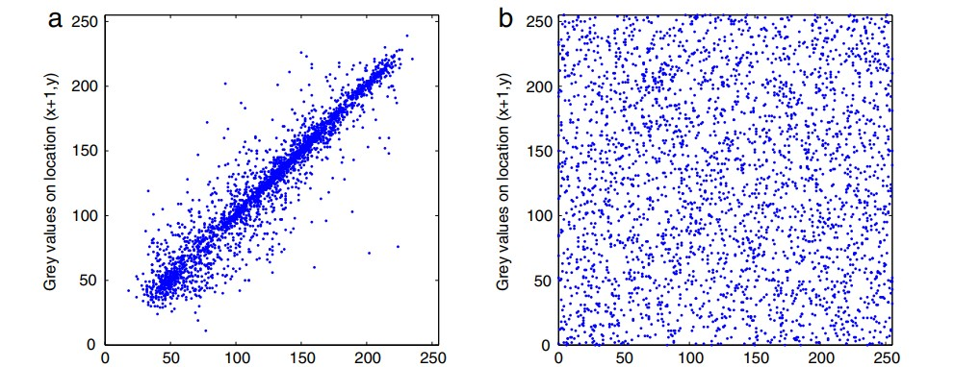
5.System Design and Implementation
Grey values on location (x, y) Grey values on location (x, y)
Fig 5.2: Correlation of two horizontally adjacent pixels in the original image and in the encrypted image.
Correlation coefficient analysis: As far as we know the correlation of between adjacent pixels in the original image is very high. An effective encryption algorithm can reduce the correlation between adjacent pixels, in order to test the correlation of two adjacent pixels. Fig (a)shows the correlation of two horizontally adjacent pixels in the original image and its encrypted image. Fig(b) shows that the correlations of adjacent pixels in the encrypted image are greatly reduced.
6/24/2022
Image encryption using DNA addition combining with chaotic maps
15

Slide 13
5.System Design and Implementation
Resistance to differential attack:
Attackers often make a slight change to the original image, and use the proposed algorithm to encrypt for the original image before and after changing, through comparing two encrypted image to find out the relationship between the original image and the encrypted image. It is called differential attack.
Information entropy:
The information entropy can measure the distribution of grey values in the image. If the distribution of grey values is more uniform, the information entropy is greater.
6/24/2022
Image encryption using DNA addition combining with chaotic maps
16

Slide 14
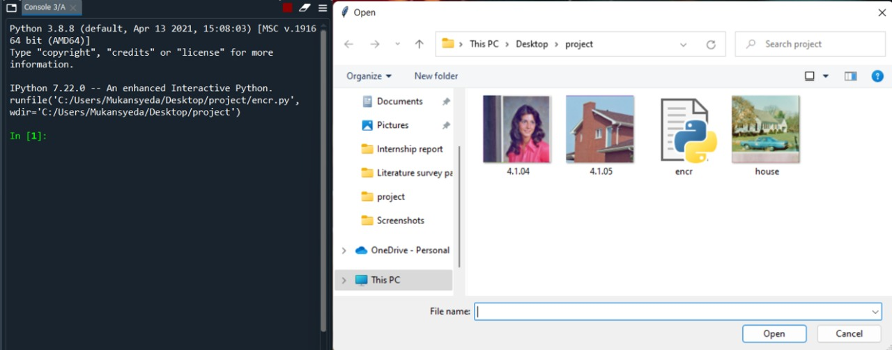
6. Results
After running of code we get the option to choose which image is to be encrypted .
6/24/2022
Image encryption using DNA addition combining with chaotic maps
18

Slide 15
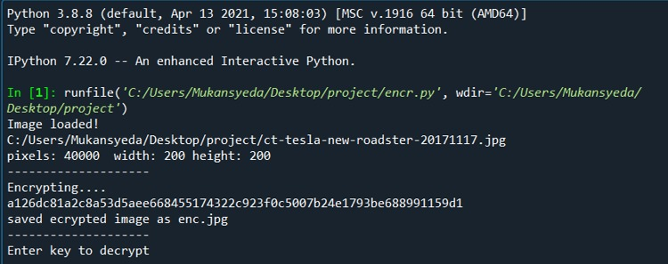
6. Results
In this we got the encryption key after running of code and selecting an image which is to be decrypted.
6/24/2022
Image encryption using DNA addition combining with chaotic maps
19

Slide 16
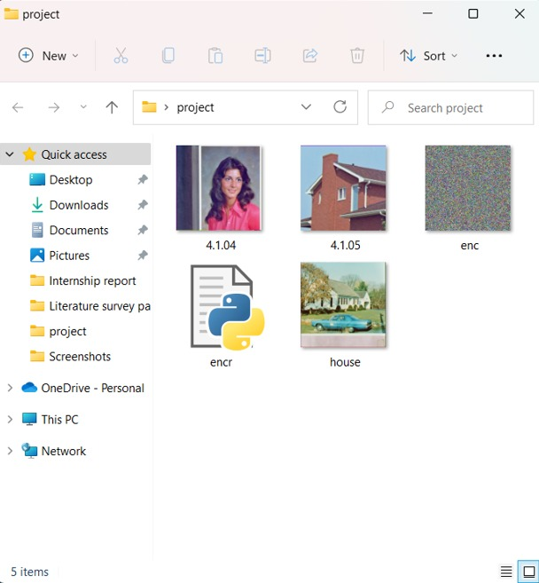
6. Results
Encrypted image is shown
6/24/2022
Image encryption using DNA addition combining with chaotic maps
20

Slide 17
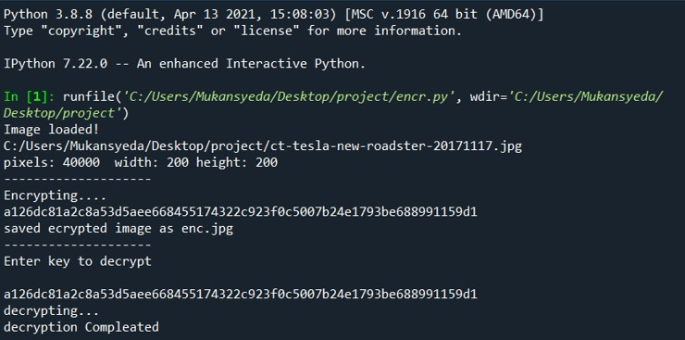
6. Results
To decrypt the code is to be pasted and run the program.
6/24/2022
Image encryption using DNA addition combining with chaotic maps
21

Slide 18
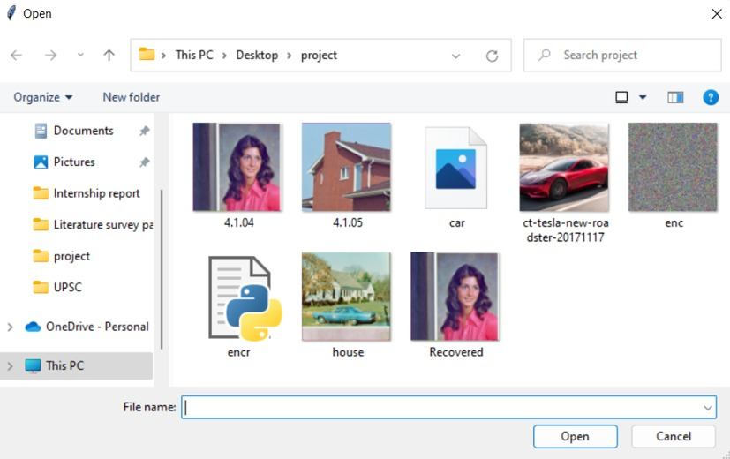
6. Results
This is the last stage where we can get to see the recovered image after decryption.
6/24/2022
Image encryption using DNA addition combining with chaotic maps
22

Slide 19
7.Analysis
To secure image encryption schemes, We present an image encryption using 1 D logistic map. The proposed scheme is based on key stream generator for confusion process. The confusion process is initiated by a secret key of 256 bits which is itself generated by a logistic map. To make the cipher(a secret code) more dynamic against any attack, the secret key is modified after encrypting each block of the image. The experimental results show that the proposed method provides an efficient and secure way for real-time image encryption and transmission.
6/24/2022
Image encryption using DNA addition combining with chaotic maps
23

Slide 20
8. References
Qiang Zhang, Ling Guo, Xiaoping Wei, “Image encryption using DNA addition combining with chaotic maps”, In proceedings of, Ling Guo from 20-09-2019.
Tian Tian Zhang, Shan Jun Yan, Cheng Yan Gul, Ran Ren1 and Kai Xin Liao, “Encryption is an efficient way to keep image data free from attackers”, In proceedings of, Shan Jun Yan from 09-06-2018.
Muhammad Samiullah, Waqar Aslam, Hira Nazir, M. Ikramullah Lali, Basit Shahzad, Muhammad Rafiq Mufti, And Humaira Afzal, “The significance of information security is increasing with digitization”, In proceedings of, Waqar Aslam from January 31, 2020 to February 11, 2020.
Zeeshan Ahmad, Hafiz Umar, Chundong Li, and Ling Chen, “A DNA-Based Security solution Using Aggregated Chaos Cross and Cubic Map”, In proceedings of, Hafiz Umar from June 17, 2019 to august 16, 2019.
Saleh Ibrahim, Hesham Alhumyani, Mehedi Masud, Sultan S Alshamrani, Omar Cheikhrouhou, Ghulam Muhammad, M. Shamim Hossain, AND Alaa M. Abbas, “Framework for Efficient Medical Image Encryption using Dynamic S-Boxes and Chaotic Maps”, In proceedings of, Ghulam Muhammad from July 25, 2019 to septmeber 18, 2021.
6/24/2022
Image encryption using DNA addition combining with chaotic maps
24

Slide 21
8. References
6. E.E. García-Guerreroa, E. Inzunza-González a, O.R. López-Bonillaa, J.R. Cárdenas-Valdez b, E. Tlelo-Cuautle, “Randomness improvement of chaotic maps for image encryption in a wireless communication scheme using PIC-microcontroller via Zigbee channel”, In proceedings of O.R. López-Bonillaa from July 25, 2019 to January 22,2020.
7. QIAN LIU AND LINGFENG LIU, “Color Image Encryption Algorithm Based on DNA Coding and Double Chaos System”, In proceedings of Ling feng Liu, from April 22 2020, To May 15 2020.
8. AMIRA G. MOHAMED 1, NOHA O. KORANY 2, AND SAID E. EL-KHAMY 2. “New DNA Coded Fuzzy Based (DNAFZ) S-Boxes”, In proceedings of Amira G. Mohamed, from January 12 2021, To January 26, 2021.
9. HEGUI ZHU, YIRAN ZHAO, AND YUJIA SONG, “A selective cross-substitution technique for encrypting color images using Chaos, DNA rules and SHA-512”, In proceedings of Hegui Zhu, from 2019 to 2020.
10. Aqeel Ur Rehman, Huiwei Wang, Malik M. Ali Shahid, Salman Iqbal, Zahid Abbas, Amnah Firdous, “A selective cross-substitution technique for encrypting color images using Chaos, DNA rules and SHA-512”, In proceedings of Huiwei Wang, from February 14, 2020 to June 1, 2020
6/24/2022
Image encryption using DNA addition combining with chaotic maps
24

Slide 22
THANK YOU

